Slide 1

P peline
The Data
Visualizing for Others
© Jennifer Mankoff
The Data Pipeline; HCII; Spring 2014

Slide 2
The Human Side of Visualization
A Visualization is successful if it helps the user

Slide 3
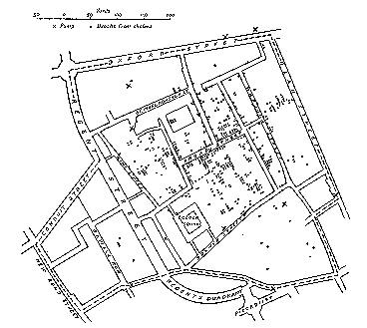
Mystery: what is causing a cholera epidemic in London in 1854?
Illustration of John Snow’s
deduction that a cholera epidemic
was caused by a bad water pump, circa 1854.
Horizontal lines indicate location of deaths.
From Visual Explanations by Edward Tufte, Graphics Press, 1997

Slide 4
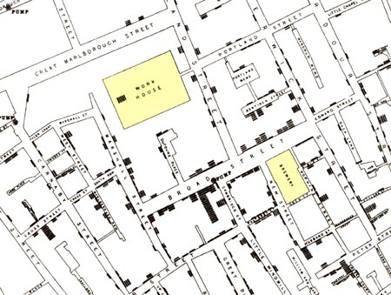
Success – user learned something
Illustration of John Snow’s
deduction that a cholera epidemic
was caused by a bad water pump, circa 1854.
Horizontal lines indicate location of deaths.
From Visual Explanations by Edward Tufte, Graphics Press, 1997

Slide 5
Planning a Visualization
What is its goal?
What visual queries does it support?
What are some compelling, useful examples? [COPY COPY COPY!]
Could it have been done more simply?
Have there been usability studies done? What do they show?

Slide 6
Planning a Visualization
What is its goal?
Does it use good design?
Have there been usability studies done? What do they show?

Slide 7
Two Different Primary Goals:
Explore/Calculate
Analyze
Reason about Information
Communicate
Explain
Make Decisions
Reason about Information

Slide 8
Two Different Primary Goals:
Explore/Calculate
Analyze
Reason about Information
Communicate
Explain
Make Decisions
Reason about Information

Slide 9
Making Queries
Define the query[ies] you wish to support
“The special skill of designers … [is] the talent to analyze a design in terms of its ability to support the visual queries of others…”
Patterns ⬄ visual system
Cognitive process prediction
A continual fresh eye

Slide 10
Rzeszotarski & Kittur: Kinetica: Dynamic Exploration
Notes:
We found that physics-based interactions helped users explore multiple dimensions at once, make more descriptive and comparative findings about their data, and develop a more holistic understanding of a dataset. We invited 16 participants to use the software for 45 minutes in a lab study. As a comparison case, we also invited another group of 16 participants to follow the same study protocol using Excel rather than the application. Interestingly, Kinetica users made far more descriptive, comparative, and relationship findings than their Excel peers who almost always made point or statistical findings (Figure 7; c²(5)=31.3, p<0.001).

Slide 11
Two Different Primary Goals:
Explore/Calculate
Analyze
Reason about Information
Communicate
Explain
Make Decisions
Reason about Information

Slide 12
Communication should:
Make large datasets coherent
Compact
Multivariate
Present information from various viewpoints
Support visual comparisons [Tufte]
Tell stories about the data (causality & structure...)
Have visual integration (images, words, etc.)
Document for credibility (baseline, scale, context)
Notes:
But remember “analytical presentations ultimately stand or fail depending on the quality, relevance, and integrity of their content” [Tufte, Beautiful Evidence, p. 136]

Slide 13
Planning a Visualization
What is its goal?
Does it use good design?
Does it account for human abilities
What are some compelling, useful examples? [COPY COPY COPY!]
How can we handle big data?
Have there been usability studies done? What do they show?
Notes:
(and do they match the goal?)

Slide 14
What can people easily decode?
Ranked Order:
Position along a common scale (e.g., scatterplot)
Position along identical but non-aligned scales (e.g., table of scatter plots)
Length (e.g., bar chart)
Then angle & slope (pie chart); area (bubbles); volume/density/color (heatmap) and hue
William S. Cleveland and Robert McGill (1984) Graphical Perception: Theory, Experimentation, and Application to the Development of Graphical Methods (J. Am. Statistical Association)

Slide 15
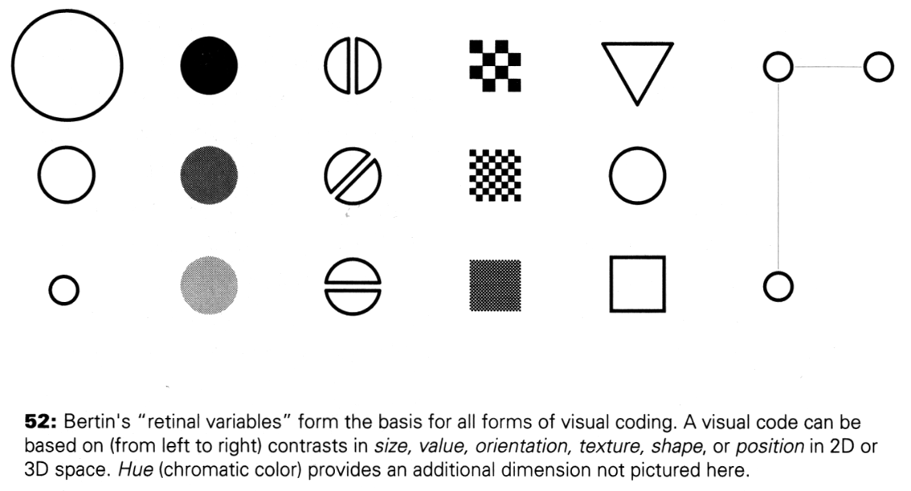
Making Things Distinct
Size
Value
Orientation
Texture
Shape
Position (2D / 3D)
Kevin Mullet and Darrell Sano, Designing Visual Interfaces
Slide from Marti Hearst/Jeff Heer via Jason Hong
Notes:
Note that while size and other cues provide for quantitative comparison, color (even luminance) only provides for ordering.
If the goal is contrast along any of these axes, make it distinct!

Slide 16
A summary of design elements
Use the eye for pattern recognition: people are good at
Scanning
Recognizing
Remembering images
What they do depends on their “visual query”
Tends to be “just in time”
Key graphical elements
Length
Shape
Orientation
Texture
Animation shows changes across time
Color helps make distinctions
Aesthetics make the process appealing

Slide 17
Planning a Visualization
What is its goal?
Does it use good design?
Does it account for human abilities
What are some compelling, useful examples? [COPY COPY COPY!]
Have there been usability studies done? What do they show?
Notes:
(and do they match the goal?)

Slide 18
Holistic Design Goals
Data & View Specifications | Visualize (choose encoding) Filter (focus on relevant items) Sort (expose patterns) Derive values or models
View Manipulation | Select (to highlight, filter, or manipulate) Navigate (zoom to examine patterns & detail) Coordinate (linked exploration) Organize windows and workspaces.
Process & Provenance | Record analysis histories Annotate patterns to document findings. Share views and annotations Guide users through analysis tasks or stories.
Heer & Shneiderman: Interactive Dynamics for Visual Analysis; ACM QUEUE, Feb 20, 2012
Notes:
Tailor to the application and the domain
Create highly interactive and integrated systems
Embed the visualization within a larger application
Provide alternative views

Slide 19
Holistic Design Goals
Data & View Specifications | Visualize (choose encoding) Filter (focus on relevant items) Sort (expose patterns) Derive values or models
View Manipulation | Select (to highlight, filter, or manipulate) Navigate (zoom to examine patterns & detail) Coordinate (linked exploration) Organize windows and workspaces.
Process & Provenance | Record analysis histories Annotate patterns to document findings. Share views and annotations Guide users through analysis tasks or stories.
Heer & Shneiderman: Interactive Dynamics for Visual Analysis; ACM QUEUE, Feb 20, 2012

Slide 20
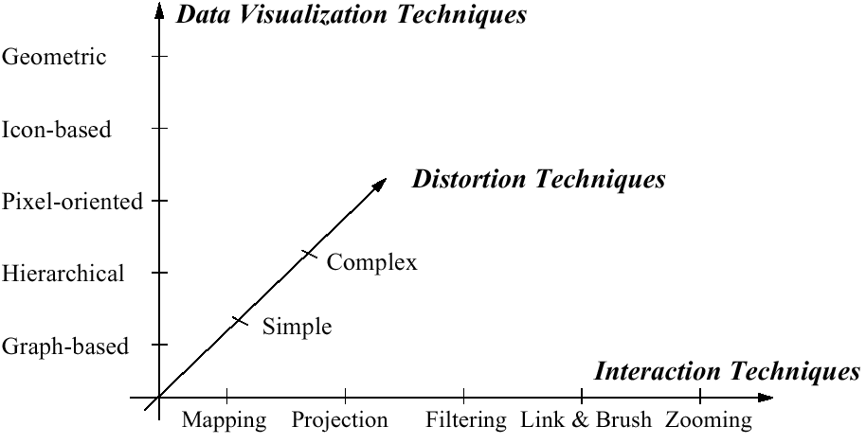
Visualization Techniques
http://www.visual-literacy.org/periodic_table/periodic_table.html
Notes:
nguyen

Slide 21
Planning a Visualization
What is its goal?
Does it use good design?
Does it account for human abilities
What are some compelling, useful examples? [COPY COPY COPY!]
Have there been usability studies done? What do they show?
Notes:
(and do they match the goal?)

Slide 22
Key Questions to Ask About a Visualization
What is its goal?
Does it use good design?
Have there been usability studies done? What do they show?
Notes:
(and do they match the goal?)

Slide 23
Does visualization help?
The jury is still out
More and more studies are being done
Still supplemental at best for text collections
A correlation with spatial ability
Learning effects: with practice ability on visual display begins to equal that of text

